Slide 1
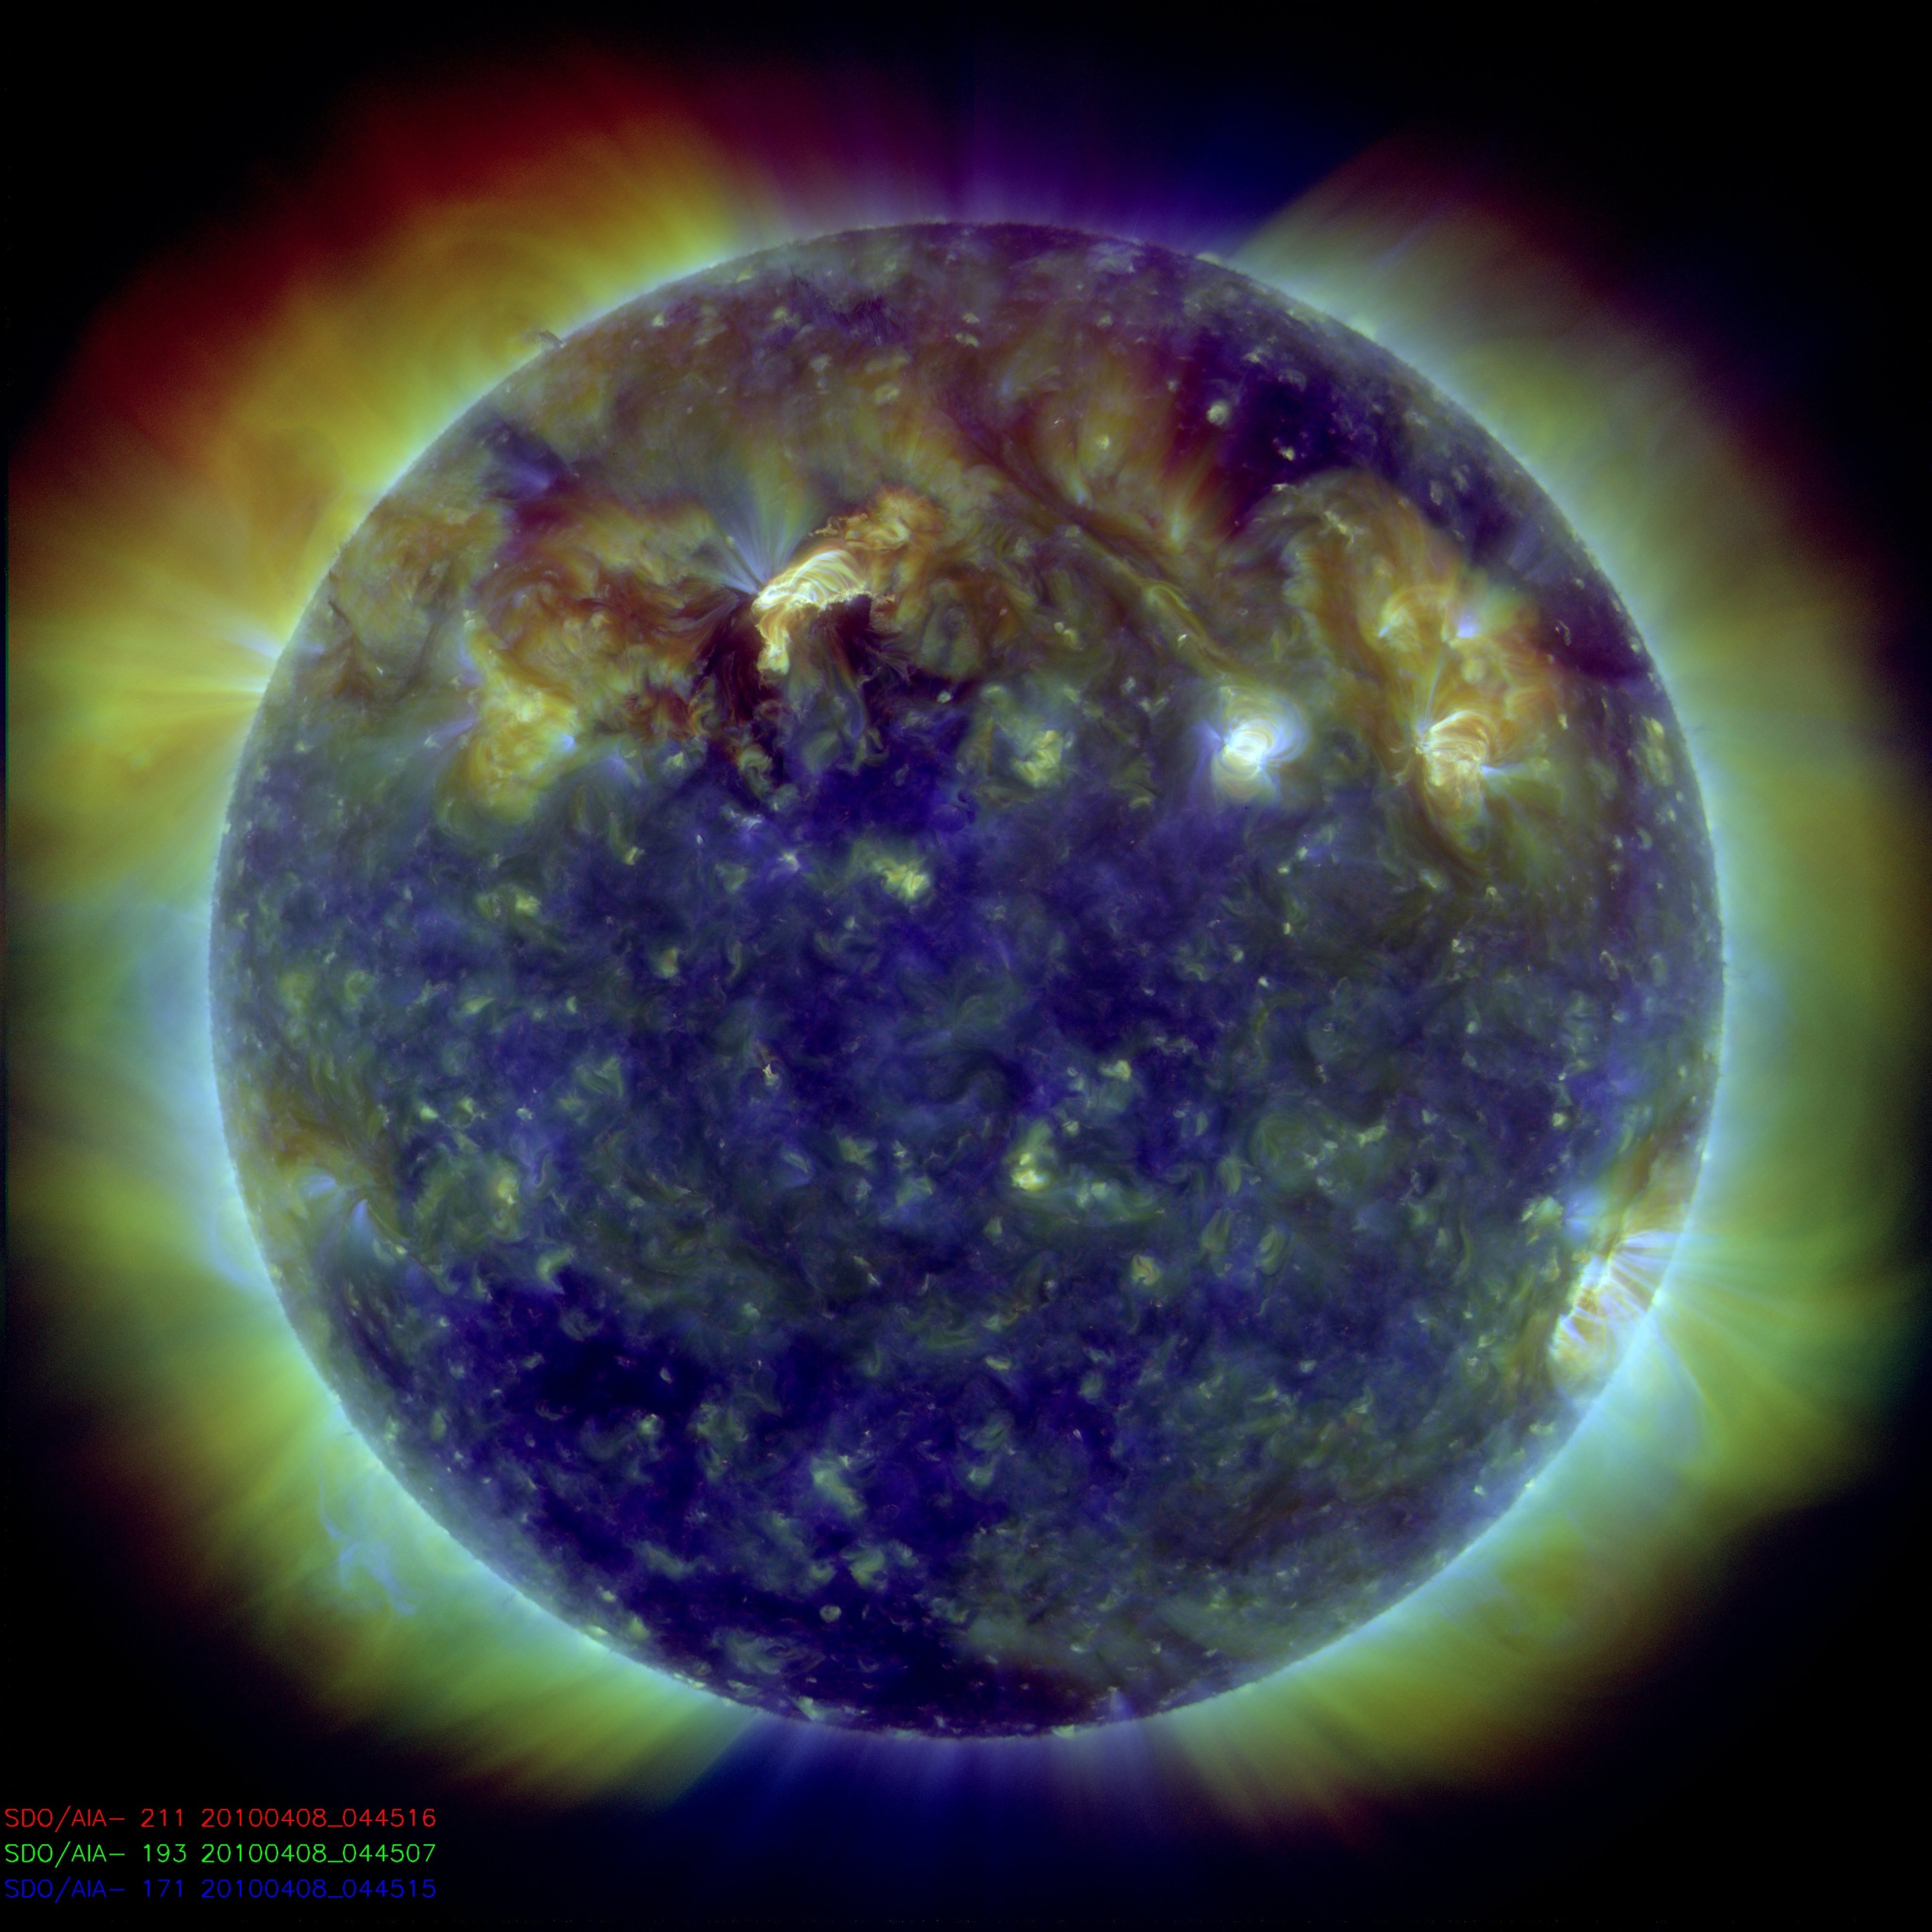
DISTRIBUTING AND MINING SDO DATA IN EUROPE
S. Parenti¹, V. Delouille², S. Dalla³, K. Bocchialini¹, H. Ballans¹, D. Boyes², S. Chapman³, J.-F. Hochedez², B. Mampaey², M. S March³, E. Soubrie¹, R. W. Walsh³
IAS, CNRS / Univ. Paris Sud XI, Orsay Cedex, France
Royal Observatory of Belgium, Brussels, Belgium
University of Central Lancashire, Preston, United Kingdom

Slide 2
Motivations for European data centers
The Data Centers in Europe will:
Give a quick access to the data (level 1) avoiding saturation of the JSOC line.
Provide additional and complementary services to the EU (and not only) community that those proposed by JSOC.
Archiving, data distribution, forecasting activities…

Slide 3
The host institutes
Three institutes with special interest on AIA data:
ROB: European hub for AIA data, redistribution (e.g. via VO-Soteria, see presentation Boyes), archive tailored to user’s demands, participation in Feature Finding Team of SAO
UCLAN…
MEDOC/IAS: solar data archive since 1996. Provides various services to the solar community. Highly involved in the science with SDO.

Slide 4
The AIA data flow
JSOC (US)
1.5 Tb/d
Level 1.n data
SAO (US)
IAS (FR)
UCLAN (UK)
ROB (BE)
VSO
VSO
USERS

Slide 5
ROB Data Center, Be
Technical Goals:
Retrieving AIA and HMI data from SAO, and serving UCLan
Redistribution to end-users via VSO and VO-SOTERIA,
Local copy of Helioviewer for quick visualization
Partial archive, tailored to user’s demands
Science Goals:
Active regions and coronal holes study
EIT waves and dimmings
Motion and brightness variation estimation
Loop cooling and heating

Slide 6
ROB Data Center
Means: PRODEX and ROB funding for SDO data center (wissdom.oma.be)
database servers (High availability, 300TB purchased)
computing and web servers (8 nodes in cluster, 32 cores, 6 NDVIA)
System software (Centos 5.4 OS, netDRMS and JMD)
Realisation: cooperation within Solar-Terrestrial Center of Excellence (STCE)

Slide 7
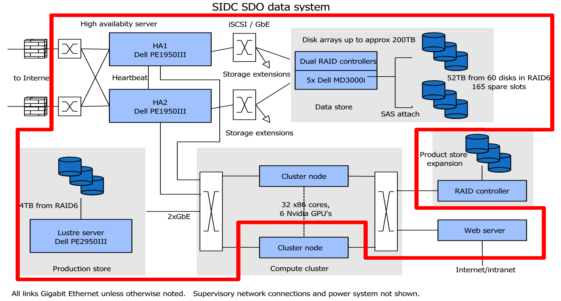
ROB Data Center
Current storage 52TB, total of 208TB on order, capacity for 338TB.
Compute cluster on ROB intranet, web server for external users

Slide 8
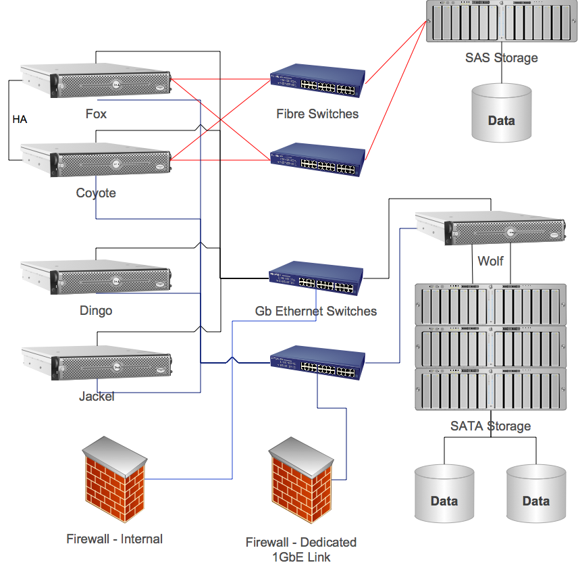
University of Central Lancashire Data Center, UK
Technical Goals:
The only SDO archive in the UK, where a large solar community is very active and interested in SDO
Hosting, retrieving and serving the full resolution high cadence recent data in all wavelengths.
Retaining a long term dataset at lower cadence
Means:
Funded by UCLan’s research equipment fund, 96 TB of data storage to hold a running archive of SDO AIA data
Dedicated 1Gb link to JANET backbone

Slide 9
UCLan: pipeline and science
Retrieving AIA data from ROB and serving IAS
Data download is progressing well after initial network issues
Data will be made available via a VSO interface
Helioviewer will be installed locally for browsing and data selection
Plan to expand the storage as the SDO mission matures
Algorythms on prominence detection (Labrosse et al 2010) and EUV dimming (Bewsher et al 2008)
Science themes include thermal analysis of coronal loops, coronal oscillations, bright point studies, magnetic field reconstruction

Slide 10
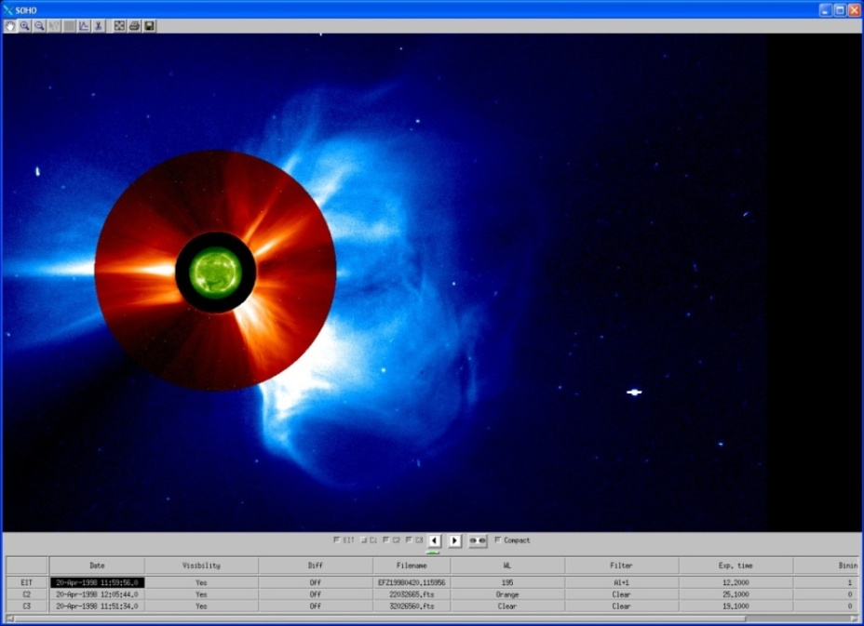
MEDOC Data Center at the Intitut d’Astrophysique Spatial, Fr
Technical Goals:
Permanent archiving and re-distributing 10-20% of the Level 1 data.
Provide services (JPEG 2000 images from SAO, movies, catalogue, visualization and detection tools)
Realization:
uses its 15 years of experience in solar and stellar data archive (SOHO, CORONAS, STEREO, TRACE, ……)
See also Poster Parenti et al….
FESTIVAL

Slide 11
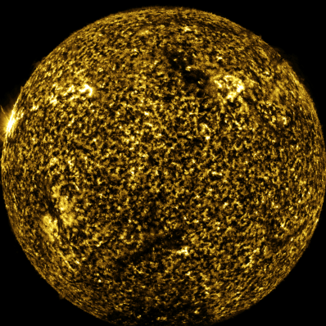
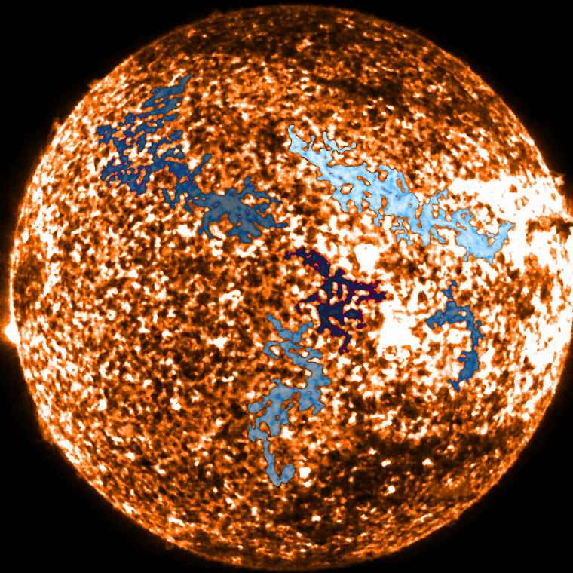
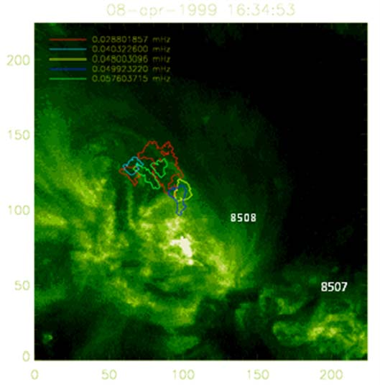
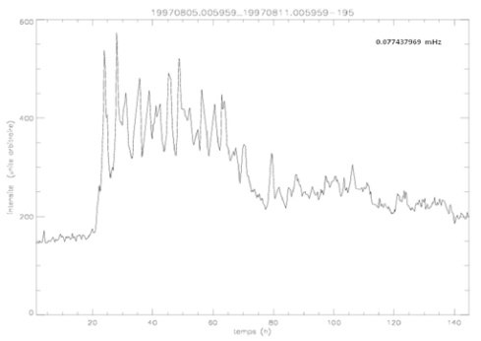
IAS: Science Goals
Prominence and prominences eruptions (Buchlin talk E22)
Long period intensity oscillations (Auchère talk E22)
AR, loops and coronal heating
3D irradiance modeling
Plume morphology
Small-scale activity in the quiet Sun (heating events, turbulence, intermittency)
Helioseismology (PICARD-HMI)
Automatic tool
Automatic tool
See also Delouille talk later…

Slide 12
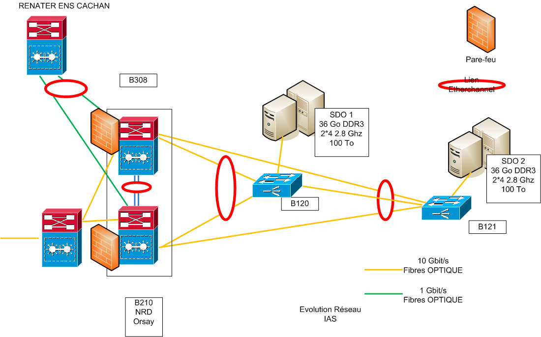
IAS Network and Means
100 % funded Topology
VSS/VRF technology
Means for SDO:
MEDOC resources (CNES)
80 TB/year plus redundancy of the critical elements with automatic swhich of the services

Slide 13
Resources for collaboration between institutes
Regular meetings and teleconference, and use of internet:
Wiki's
For each group to informally publish progress (wissdom.oma.be for ROB)
For intragroup coordination (e.g. wiki on JMD development)
Shared by all groups by topic
Public and private
Mailing lists for SDO data sites
Quick and easy, e.g. to send alert in case of problem
Software and document sharing
Document versioning
Software release and visibility (jsoc.stanford.edu/netdrms)
Issue tracking

Slide 14
Conclusion and future activities
3rd SDO pipeline meeting in September with e.g. discussion on archiving system in Europe
Redistribution of data:
VSO, VO-SOTERIA, other means to be discussed
Proposal to ESA to make SDO a ‘mission of interest’ (in preparation)
Open to any request/suggestions from the community in terms of services.

Slide 15
Mining SDO data in Europe
An outline of the activity of the ISSI Int’l team on “Mining and Exploiting SDO data in Europe”
Véronique Delouille and the Soldyneuro team

Slide 16
ISSI team on ‘Mining and exploiting SDO data in Europe’
Response to the 2009 call, 20 out of 60 proposals selected
1st meeting in Oct. 2009, 2nd in April 2010
Objectives:
Coordination in development of automated tools for analyzing SDO data (comparison between algorithm, study of statistical properties)
Combined use of these tools to help answering science questions

Slide 17
The ‘Soldyneuro’ team
USA
LMSAL Karel Schrijver, Neal Hurlburt
SAO Piet Martens, Alec Engell, Justin Kasper
UK and Ireland
U. Glasgow Nicolas Labrosse, Fraser Watson
U. central Lancashire Robert Walsh, Silvia Dalla, Stéphane Régnier
U. Bradford Tufan Colak, Rami Qahwaiji
Trinity College Dublin Peter Gallagher, Paul Higgins
Continental Europe
MPS Davina Innes
IAS Frédéric Auchère, Susanna Parenti, Eric Buchlin
ROB Véronique Delouille (L), Jean-François Hochedez, Cis Verbeeck, Catherine Timmermans
U. Orléans Thierry Dudok de Wit, Matthieu Kretzschmar, Luis Vieira
U. Zagreb Roman Brajša
,

Slide 18
Coordination in development of automated tools for detection of:
Sunspot, faculae detection
Magnetic active region, magnetic fragments
Global polarity inversion line, local polarity separation line
Coronal active region
Prominences, filaments
Oscillation in the corona
Photospheric and coronal motion study
Notes:
Here are the several tools that members of the ISSI team have been developing. A first aim was to include these algorithms in the HEK, and so we coordinate to solve problem that were common to all algorithms for such inclusion

Slide 19
Science questions
How do photospheric features contributes to the TSI and the SSI?
Who are the precursors for flares?
How do motion of magnetic fragments correlates with photospheric flow?
What is the coronal responses of photospheric features?
How do filaments, coronal holes, global PSL, and ARs fit co-spatially?
Notes:
Science questions that we wanted to address using a.o. these algorithms, are the following:
Photosphereic feature: sunspot, umbrae and penumbrae, faculae, network contribute to the total solar irradiance and spectral solar irradiance.
Who are the precursors for flares;
Motion : how correlate :study inhibition of convection by AR, as well as how
flows near sunspots and AR behave
Coronal responses to photospheric features: emergence of AR

Slide 20
Life Cycle of Solar Image Processing
Development of
automated detection
algorithms
Feedback for
new requirements
Combination
of algorithms to
address Science questions
Comparison algorithms,
Performance evaluation

Slide 21
How do photospheric features contributes to the TSI/SSI?
Semi-empirical model assumes that B-field at solar surface causes TSI + SSI
variations in UV, visible, IR components:
Sunspots, faculae, network, Quiet Sun
(Wenzler ‘06, Krivova ’03, …)
Need of robust detection method to estimate the filling factor of these features with precisions

Slide 22
Sunspot and faculae detection
Fraser Watson, U. Glasgow
Bradford team
Detection of
Sunspot on
HMI
Detection of faculae on MDI continuum
(heliographic coordinate)
28th March 2001
29th April 2010
Notes:
Detection of sunspot:
The background profile is estimated using Morphological operation (dilation, erosion)
Threshold set on the smooth image, where background has been substracted.
Faculae: heliographic cooridnate, neural network, and adaptive thresholding

Slide 23
Who are the precursors for flares?
Large-scale Investigation of AR Properties with respect to Flaring Events
Teams:
University of Bradford: AR-flare associations, statistical Feature selection, and machine learning-based prediction techniques.
Trinity College Dublin: AR detection and property extraction by applying the SMART (Solar Monitor Active Region Tracking) algorithm on Solar Cycle 23.
Notes:
Second question i want to talk to you about is the haunting question of flare precursors
23

Slide 24
Magnetic AR Properties extracted by SMART (TCD Team)
 | AR Properties | Description
1 | Type-Polarity | Unipolar/Multipolar
2 | Type-Size | Big/Small
3 | Type-Evolution | Emerging/Decaying
4 | Area_Mmsq | Area of the region [Megameters squared]
5 | Bflux_Mx | Total unsigned magnetic flux of the region [Maxwells]
6 | Bfluxp_Mx | Total positive flux in the region [Maxwells]
7 | Bfluxn_Mx | Total negative flux in the region [Maxwells]
8 | Bfluximb | Flux imbalance fraction in the region = (Bfluxp_Mx+abs(Bfluxn_Mx)) /Bflux_Mx [fraction]
9 | DBfluxDt_Mx | The flux emergence rate = ( (Bflux_Mx at time t) - (Bflux_Mx at time (t - delta t)) ) / (delta t) [Mx / second]
10 | Bmin_G | Minimum B value in the region [Gauss]
11 | Bmax_G | Maximum B value in the region [Gauss]
12 | Bmean_G | Mean B value in the region [Gauss]
13 | Lnl_Mm | Neutral line length in the region [Mega meters]
14 | Lsg_Mm | High gradient Neutral line length in the region [Mega meters]
15 | MxGrad_GpMm | Maximum gradient along the Neutral line. [Gauss / Megameter]
16 | MeanGrad | Mean gradient along the Neutral line. [Gauss / Megameter]
17 | MednGrad | Median gradient along the Neutral line. [Gauss / Megameter]
18 | Rval_Mx | Schrijver R-Value. [Maxwells]
19 | WLsg_GpMm | Falconer WLsg value [Gauss / Megameter]
20 | R_Str | Schrijver R-Value with a lower threshold for summing flux [Maxwells]
21 | WLsg_Str | A modified version of WLsg
Notes:
24

Slide 25
Bradford Team
 | Best Properties INITIAL RESULTS
4 | Area_Mmsq
7 | Bfluxn_Mx
9 | DBfluxDt_Mx
10 | Bmin_G
11 | Bmax_G
15 | MxGrad_GpMm
16 | MeanGrad
17 | MednGrad
21 | WLsg_Str
SMART’s AR Properties
NGDC Flare Catalogue
Association, using Date, Time and Location
Associated Data – Full Set
Feature Selection
Best Features
Machine Learning
Machine Learning
Full-Set Evaluation
Best Properties Evaluation
Data Set | True Positive | False Positive | False Negative | True Negative | Accuracy | Mean Square Error Rate | False Alarm Rate | Heidke Skill Score
Full-Set | 0.926 | 0.013 | 0.074 | 0.987 | 0.963 | 0.023 | 0.022 | 0.921
Best Properties | 0.932 | 0.010 | 0.068 | 0.990 | 0.965 | 0.022 | 0.013 | 0.928

Slide 26
Future prospects
Continued collaboration (teleconference, meeting, google group, 3rd meeting in 2011)
.
http://www.sipwork.org/sipworkV/
Splinter sessions on:
Solar Eruptive Events
Solar Disk Features
Reconstruction of the 3-D solar atmosphere
Differential emission measure, solar activity and irradiance reconstruction

Slide 27
Backup slides

Slide 28
ROB Data Center
For database servers
Duplicated database servers in high availability cluster configuration
5 RAID arrays with duplicated controllers for data storage
Duplicated internet connections to physically separate external cables
Dual power supplies, both in servers and computer centre, with generator backups
For computing and web servers
High speed (six parallel drives) 4TB data cache
32 x86 cores plus 6 NVIDIA GPU's for tightly bound computing
Dedicated webserver
System software
Centos 5.4 OS on database servers
netDRMS and JMD
Ganglia overall monitoring
Heartbeat/Pacemaker high availability system
Notes:
28

Slide 29
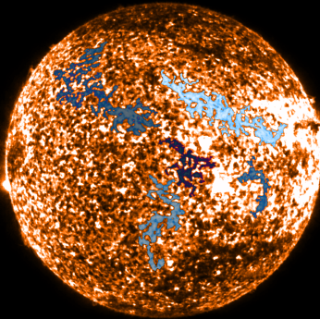
IAS: data mining (I)
Participation to the Soldyneuro team activity (Delouille presentation):
Algorythm for filaments detection using the 304 channel (see, Buchlin presentation in this session)
Catalogue and data of filament
eruptions
Algorythm for intensity oscillations in the EUV coronal channels (Auchère presentation in this session).

Slide 30
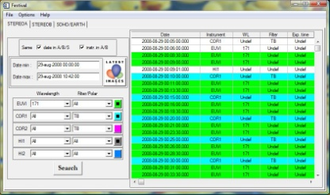
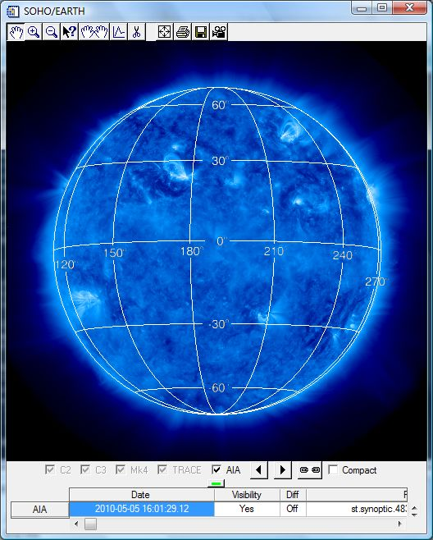
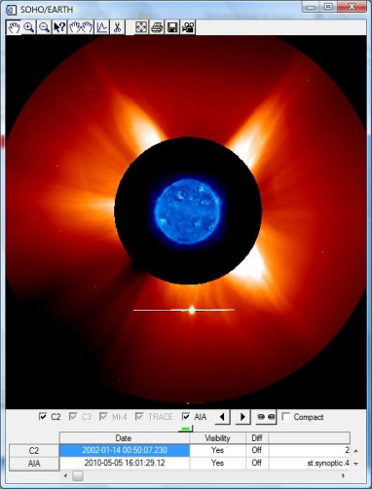
IAS: data mining (II)
Implementation of SDO data in the FESTIVAL visualization tool

Slide 31
MEDOCEDOC Numbers
Omega (since 2003)
800 orbits
200 Go raw datas
Full dataset : 1,5 To
IRIS
1 Go
CoRoT (since 2007)
>10k records/day
520 Mo/day
MRO (Sélection)
15 Go/day
Planck, Stereo,
> 3 Go/day
> 1 Go/day
SOHO (since 1996)
1,5M records
1,9To
TRACE (since 2001)
16M records
1,3To
CORONAS (2001-2005)
80k records
70Go
MOST (since 2003)
500k records
50 Go
Today : 100 To (With redundancy + backups)

